Slide 1
Managing multicore machines: pslots, draining and more
Center for High Throughput Computing

Slide 2
HELP! There’s a Cluster in my Server!
Center for High Throughput Computing

Slide 3
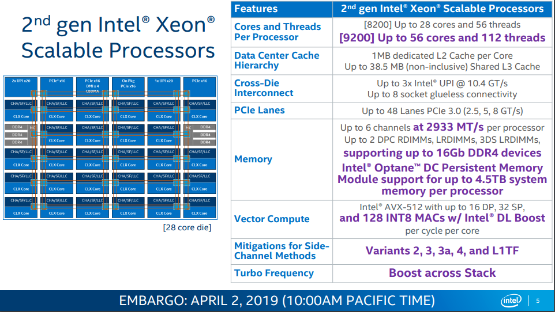

Slide 4

My Desktop Computer
8 Cores (Hyper-threaded)
16 Gigabytes RAM

Slide 5
HTCondor out of the box
1 core per slot, memory divided evenly
Create static slots from detected resources
$ condor_status
Name OpSys Arch State Activity LoadAv Mem ActvtyTime slot1@c LINUX X86_64 Unclaimed Idle 0.000 1997 0+00:00:00
slot2@c LINUX X86_64 Unclaimed Idle 0.000 1997 0+00:00:20
slot3@c LINUX X86_64 Unclaimed Idle 0.000 1997 0+00:00:20
slot4@c LINUX X86_64 Unclaimed Idle 0.000 1997 0+00:00:20
slot5@c LINUX X86_64 Unclaimed Idle 0.000 1997 0+00:00:20
slot6@c LINUX X86_64 Unclaimed Idle 0.000 1997 0+00:00:20
slot7@c LINUX X86_64 Unclaimed Idle 0.000 1997 0+00:00:20
slot8@c LINUX X86_64 Unclaimed Idle 0.000 1997 0+00:00:20
Total Owner Claimed Unclaimed Matched Preempting Backfill Drain
X86_64/LINUX 8 0 0 8 0 0 0 0
Total 8 0 0 8 0 0 0 0

Slide 6
You can Lie about Resources!
# HTCondor Config file for startd
# Tell HTCondor I’ve got 6 cores
NUM_CPUS = 6
# Memory for all slots (in Megabytes)
MEMORY = 4096
# Subtract 1GB from whatever memory is detected
RESERVED_MEMORY = 1024
# Tell HTCondor that execute disk size (in KB) is this
DISK = 10240

Slide 7
Conventional Wisdom about cores
“Modern machines have lots of cores, so I should make all my jobs each use as many cores as possible, so they finish as fast as possible”
HT Wisdom: “Probably not”

Slide 8
Rules of HT Optimization
The fewer resources a job needs,
the more places it can run
But sometimes, you just need more…

Slide 9
Slot are where jobs run
# Submit file
Executable = calculate
Arguments = 1 2 42
Request_Cpus = 2
Request_Memory = 2048
Request_Disk = 1G
Log = log
queue
Don’t Forget These – may be required!
$ condor_status
Name OpSys Arch State Activity LoadAv Mem ActvtyTime slot1@c LINUX X86_64 Unclaimed Idle 0.000 1997 0+00:00:00
slot2@c LINUX X86_64 Unclaimed Idle 0.000 1997 0+00:00:20
slot3@c LINUX X86_64 Unclaimed Idle 0.000 1997 0+00:00:20
slot4@c LINUX X86_64 Unclaimed Idle 0.000 1997 0+00:00:20
slot5@c LINUX X86_64 Unclaimed Idle 0.000 1997 0+00:00:20
slot6@c LINUX X86_64 Unclaimed Idle 0.000 1997 0+00:00:20
slot7@c LINUX X86_64 Unclaimed Idle 0.000 1997 0+00:00:20
slot8@c LINUX X86_64 Unclaimed Idle 0.000 1997 0+00:00:20
Total Owner Claimed Unclaimed Matched Preempting Backfill Drain
X86_64/LINUX 8 0 0 8 0 0 0 0
Total 8 0 0 8 0 0 0 0

Slide 10
What happens if…
# Submit file
Executable = calculate
Arguments = 1 2 42
Request_Cpus = 2
Request_Memory = 2048
Request_Disk = 1G
Log = log
queue
There are no 2 core slots?

Slide 11
Idle Forever…
$ condor_q -- Schedd: gthain@c: <10.5.1.1:33601?...
OWNER BATCH_NAME SUBMITTED DONE RUN IDLE TOTAL JOB_IDS gthain ID: 577 9/16 17:57 _ _ 1 1 577.0
Total for query: 1 jobs; 0 completed, 0 removed, 1 idle, 0 running, 0 held, 0 suspended Total for all users: 1 jobs; 0 completed, 0 removed, 1 idle, 0 running, 0 held, 0 suspended

Slide 12
What if I lie to HTCondor?
# Submit file
Executable = calculate
Arguments = 1 2 42
Request_Cpus = 1
Request_Memory = 1024
Request_Disk = 1G
Log = log
queue
And it really needs 2 cores and 4 Gb of memory?

Slide 13
Running, but in Jail!
$ condor_q -- Schedd: gthain@c: <10.5.1.1:33601?...
OWNER BATCH_NAME SUBMITTED DONE RUN IDLE TOTAL JOB_IDS gthain ID: 577 9/16 17:57 _ 1 _ 1 577.0
Total for query: 1 jobs; 0 completed, 0 removed, 1 idle, 0 running, 0 held, 0 suspended Total for all users: 1 jobs; 0 completed, 0 removed, 1 idle, 0 running, 0 held, 0 suspended

Slide 14
Solution: Partitionable Slots
2 kinds of slots:
partitionable-slots:
always unclaimed
hold unused resources
Dynamic slots
create/destroyed to fit one job

Slide 15
Enabling partionable slots
# HTCondor Config file for startd
NUM_SLOTS_TYPE_1 = 1
SLOT_TYPE_1_PARTITIONABLE = true
SLOT_TYPE_1 = cpus=100%

Slide 16
Enabling partionable slots
$ condor_status
Name OpSys Arch State Activity LoadAv Mem ActvtyTime
slot1@c LINUX X86_64 Unclaimed Idle 0.000 15976 0+08:46:59
Total Owner Claimed Unclaimed Matched Preempting Backfill Drain
X86_64/LINUX 1 0 0 1 0 0 0 0
Total 1 0 0 1 0 0 0 0

Slide 17
What’s in the p-slot?
$ condor_status -af Name SlotType Cpus Memory
slot1@c Partitionable 8 15976

Slide 18
Now this job can run…
# Submit file
Executable = calculate
Arguments = 1 2 42
Request_Cpus = 2
Request_Memory = 2048
Request_Disk = 1G
Log = log
queue
This didn’t fit with static slots

Slide 19
And this one…
# Submit file
Executable = calculate
Arguments = 1 2 42
Request_Cpus = 3
Request_Memory = 1024
Request_Disk = 1G
Log = log
queue

Slide 20
What’s in the p-slot?
$ condor_status
Name OpSys Arch State Activity LoadAv Mem
slot1@c LINUX X86_64 Unclaimed Idle 0.000 12904
slot1_1@c LINUX X86_64 Claimed Busy 0.000 2048
slot1_2@c LINUX X86_64 Claimed Busy 0.000 1024
slot1_3@c LINUX X86_64 Claimed Busy 0.000 1024
Total Owner Claimed Unclaimed Matched Preempting Backfill Drain LINUX 4 0 3 1 0 0 0 Total 4 0 3 1 0 0 0
Note the underscore
in d-slots
Note non-uniform
Memory sizes

Slide 21
What’s in the p-slot?
$ condor_status -af Name SlotType Cpus Memory
slot1@c Partitionable 0 11880 slot1_1@c Dynamic 2 2048 slot1_2@c Dynamic 3 1024 slot1_3@c Dynamic 3 1024

Slide 22
When a d-slot completes?
$ condor_status -af Name SlotType Cpus Memory
slot1@c Partitionable 3 12904 slot1_1@c Dynamic 2 2048 slot1_2@c Dynamic 3 1024 slot1_3@c Dynamic 3 1024

Slide 23
Are we good?
No – Starvation
If I submit 8 one core jobs

Slide 24
Completely used machine
$ condor_status
Name OpSys Arch State Activity LoadAv Mem
slot1@c LINUX X86_64 Unclaimed Idle 0.000 7784
slot1_1@c LINUX X86_64 Claimed Busy 0.000 1024
slot1_2@c LINUX X86_64 Claimed Busy 0.000 1024
slot1_3@c LINUX X86_64 Claimed Busy 0.000 1024
slot1_4@c LINUX X86_64 Claimed Busy 0.000 1024
slot1_5@c LINUX X86_64 Claimed Busy 0.000 1024
slot1_6@c LINUX X86_64 Claimed Busy 0.000 1024
slot1_7@c LINUX X86_64 Claimed Busy 0.000 1024
slot1_8@c LINUX X86_64 Claimed Busy 0.000 1024
Total Owner Claimed Unclaimed Matched Preempting Backfill
LINUX 9 0 8 1 0 0 0
Total 9 0 8 1 0 0 0
When can a 2-core job run?
Note total slots!

Slide 25
Starvation
If there is a supply of one core jobs…
A two-core job will never match!

Slide 26
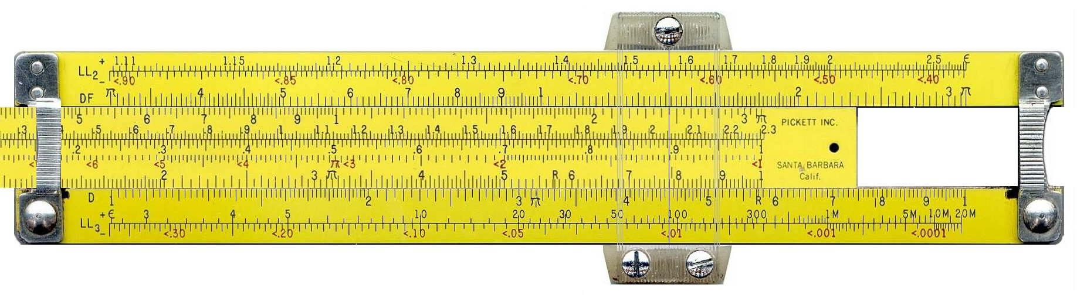
No easy solution
Need to engineer approach and make tradeoffs
Throughput vs. fairness
Establish policy
Measure performance

Slide 27
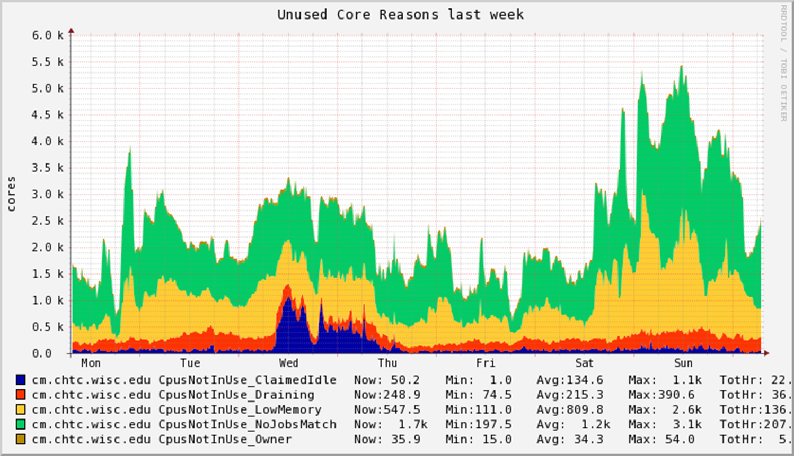

Slide 28

First approach: Steering

Slide 29

Works best when 2 sizes (cpus)
Fill 1 core jobs “left to right”
Fill 8 core jobs “right to left”

Slide 30
Pool-wide policy -> negotiator
Assume every startd advertises Longitude:
Longitude = 2.3522
START_ATTRS = Longitude
And in the negotiator, have config like…
NEGOTIATOR_PRE_JOB_RANK = \
RequestCpus == 1 ? Longitude : - Longitude

Slide 31
Brief Advertisement
Whole talk on negotiator
Google for
site:youtube.com center for high throughput computing channel

Slide 32
2nd approach: Draining
$ condor_status
Name OpSys Arch State Activity LoadAv Mem
slot1@c LINUX X86_64 Unclaimed Idle 0.000 12904
slot1_1@c LINUX X86_64 Claimed Busy 0.000 2048
slot1_2@c LINUX X86_64 Claimed Busy 0.000 1024
slot1_3@c LINUX X86_64 Claimed Busy 0.000 1024
Total Owner Claimed Unclaimed Matched Preempting Backfill Drain LINUX 4 0 3 1 0 0 0 Total 4 0 3 1 0 0 0

Slide 33
condor_drain command
$ condor_drain c
Need admin privs,
May need to run from cm machine
$ condor_status
Name OpSys Arch State Activity LoadAv Mem
slot1@c LINUX X86_64 Drained Retiring 0.000 12904
slot1_1@c LINUX X86_64 Claimed Retiring 0.000 2048
slot1_2@c LINUX X86_64 Claimed Retiring 0.000 1024
slot1_3@c LINUX X86_64 Claimed Retiring 0.000 1024
Total Owner Claimed Unclaimed Matched Preempting Backfill Drain LINUX 4 0 3 1 0 0 0 Total 4 0 3 1 0 0 0
Typo:
Should be
“DrainING”

Slide 34
How does drain work?
$ condor_status –af:r Requirements
false
false
false
false

Slide 35
condor_drain cancelling
$ condor_drain –cancel c
$ condor_status
Name OpSys Arch State Activity LoadAv Mem
slot1@c LINUX X86_64 Unclaimed Retiring 0.000 12904
slot1_1@c LINUX X86_64 Claimed Retiring 0.000 2048
slot1_2@c LINUX X86_64 Claimed Retiring 0.000 1024
slot1_3@c LINUX X86_64 Claimed Retiring 0.000 1024
Total Owner Claimed Unclaimed Matched Preempting Backfill Drain LINUX 4 0 3 1 0 0 0 Total 4 0 3 1 0 0 0

Slide 36
How long does drain last?
Jobs killed after MaxJobRetirementTime
Default is 0
This may be most underused knob in HTC
Machine stays in drained state until cancel
Even after all jobs exit
(unless –resume-on-complete) is set

Slide 37
condor_drain command
$ condor_drain –start 'BackfillableJob == true' c
$ condor_status
Name OpSys Arch State Activity LoadAv Mem
slot1@c LINUX X86_64 Drained Retiring 0.000 12904
slot1_1@c LINUX X86_64 Claimed Retiring 0.000 2048
slot1_2@c LINUX X86_64 Claimed Retiring 0.000 1024
slot1_3@c LINUX X86_64 Claimed Retiring 0.000 1024
Total Owner Claimed Unclaimed Matched Preempting Backfill Drain LINUX 4 0 3 1 0 0 0 Total 4 0 3 1 0 0 0

Slide 38
condor_drain with backfill
$ condor_submit backfillable_job.sub
$ condor_status
Name OpSys Arch State Activity LoadAv Mem
slot1@c LINUX X86_64 Drained Retiring 0.000 12904
slot1_1@c LINUX X86_64 Claimed Retiring 0.000 2048
slot1_2@c LINUX X86_64 Claimed Retiring 0.000 1024
slot1_3@c LINUX X86_64 Claimed Retiring 0.000 1024
slot1_4@c LINUX X86_64 Claimed Busy 0.000 1024
Total Owner Claimed Unclaimed Matched Preempting Backfill Drain LINUX 4 0 3 1 0 0 0 Total 4 0 3 1 0 0 0

Slide 39
Defrag daemon
Optional, can be enabled (often on CM)
Just runs condor_drain and –cancel
Never looks at queues, just at condor_status
DEFRAG_DRAINING_MACHINES_PER_HOUR
DEFRAG_MAX_WHOLE_MACHINES
DEFRAG_REQUIREMENTS

Slide 40
Thank you
Questions?
Please see htcondor.readthedocs.io

